Slide 1


Wisabi Bank
ATM Transactions Report by James Le
Time Period from January to December 2022

Slide 2
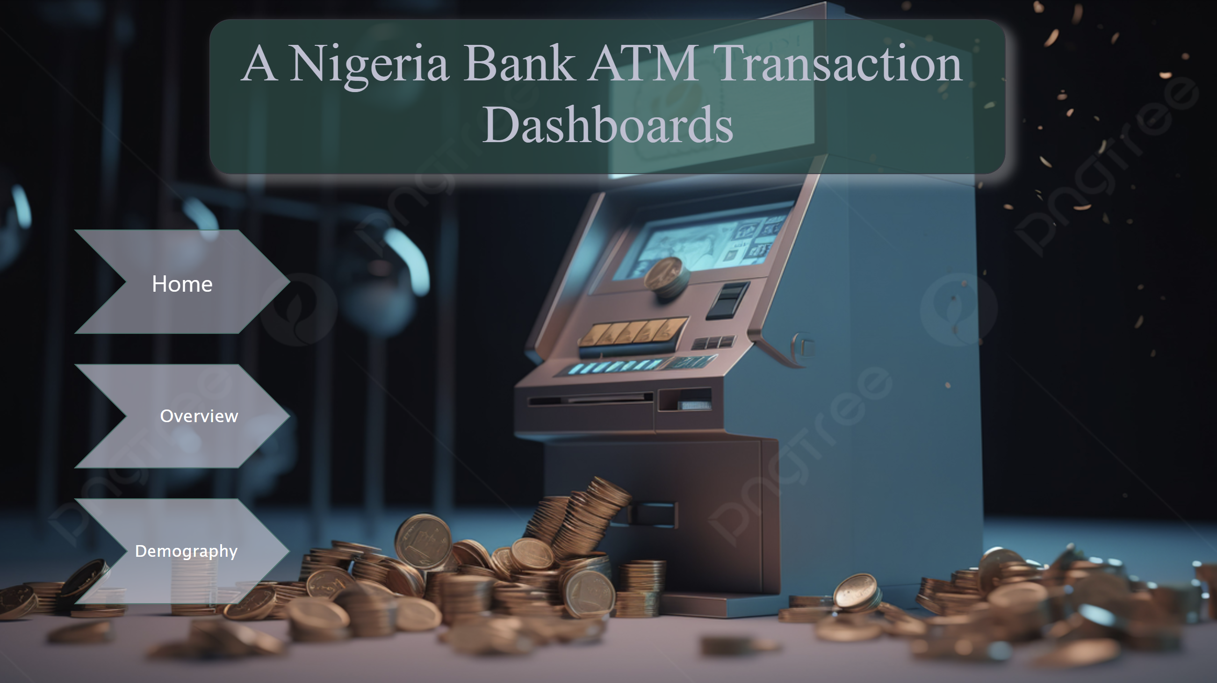
Overview
Notes:
image
No alt text provided
textbox
No alt text provided
What is the Utilization Rate by State?
No alt text provided
What is the Average Transaction Amount by State & Type?
No alt text provided
What is the Daily Trend of Transactions?
No alt text provided
What is the Trend of Transaction Amount & Count?
No alt text provided
What is the Relationship between Average Amount & Average Duration?
No alt text provided
Transaction Amount
No alt text provided
Transaction Count
No alt text provided
Utilization Rate
No alt text provided
actionButton
No alt text provided
actionButton
No alt text provided
actionButton
No alt text provided
actionButton
No alt text provided
actionButton
No alt text provided
slicer
No alt text provided
slicer
No alt text provided
slicer
No alt text provided
shape
No alt text provided

Slide 3
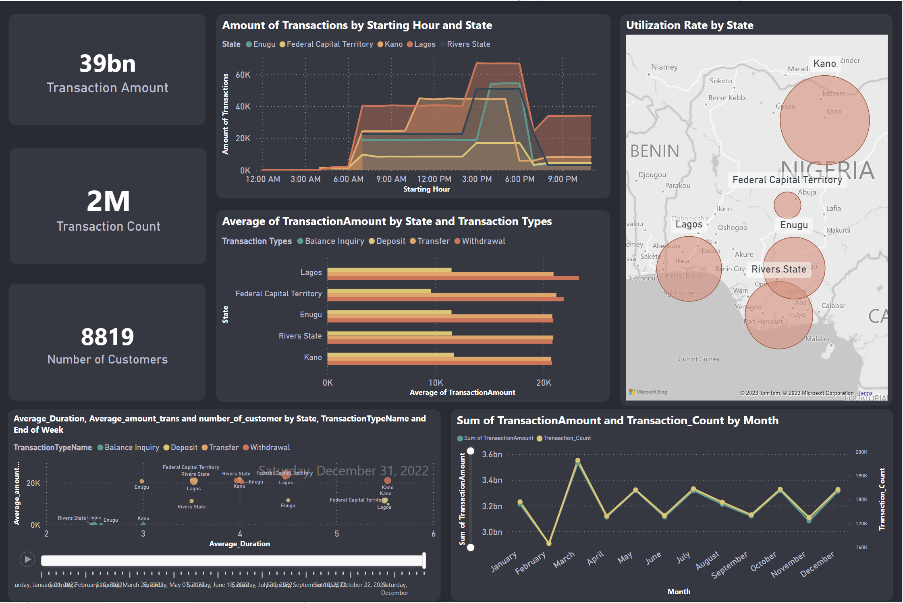
Overview
Notes:
image
No alt text provided
textbox
No alt text provided
What is the Utilization Rate by State?
No alt text provided
What is the Average Transaction Amount by State & Type?
No alt text provided
What is the Daily Trend of Transactions?
No alt text provided
What is the Trend of Transaction Amount & Count?
No alt text provided
What is the Relationship between Average Amount & Average Duration?
No alt text provided
Transaction Amount
No alt text provided
Transaction Count
No alt text provided
Utilization Rate
No alt text provided
actionButton
No alt text provided
actionButton
No alt text provided
actionButton
No alt text provided
actionButton
No alt text provided
actionButton
No alt text provided
slicer
No alt text provided
slicer
No alt text provided
slicer
No alt text provided
shape
No alt text provided

Slide 4
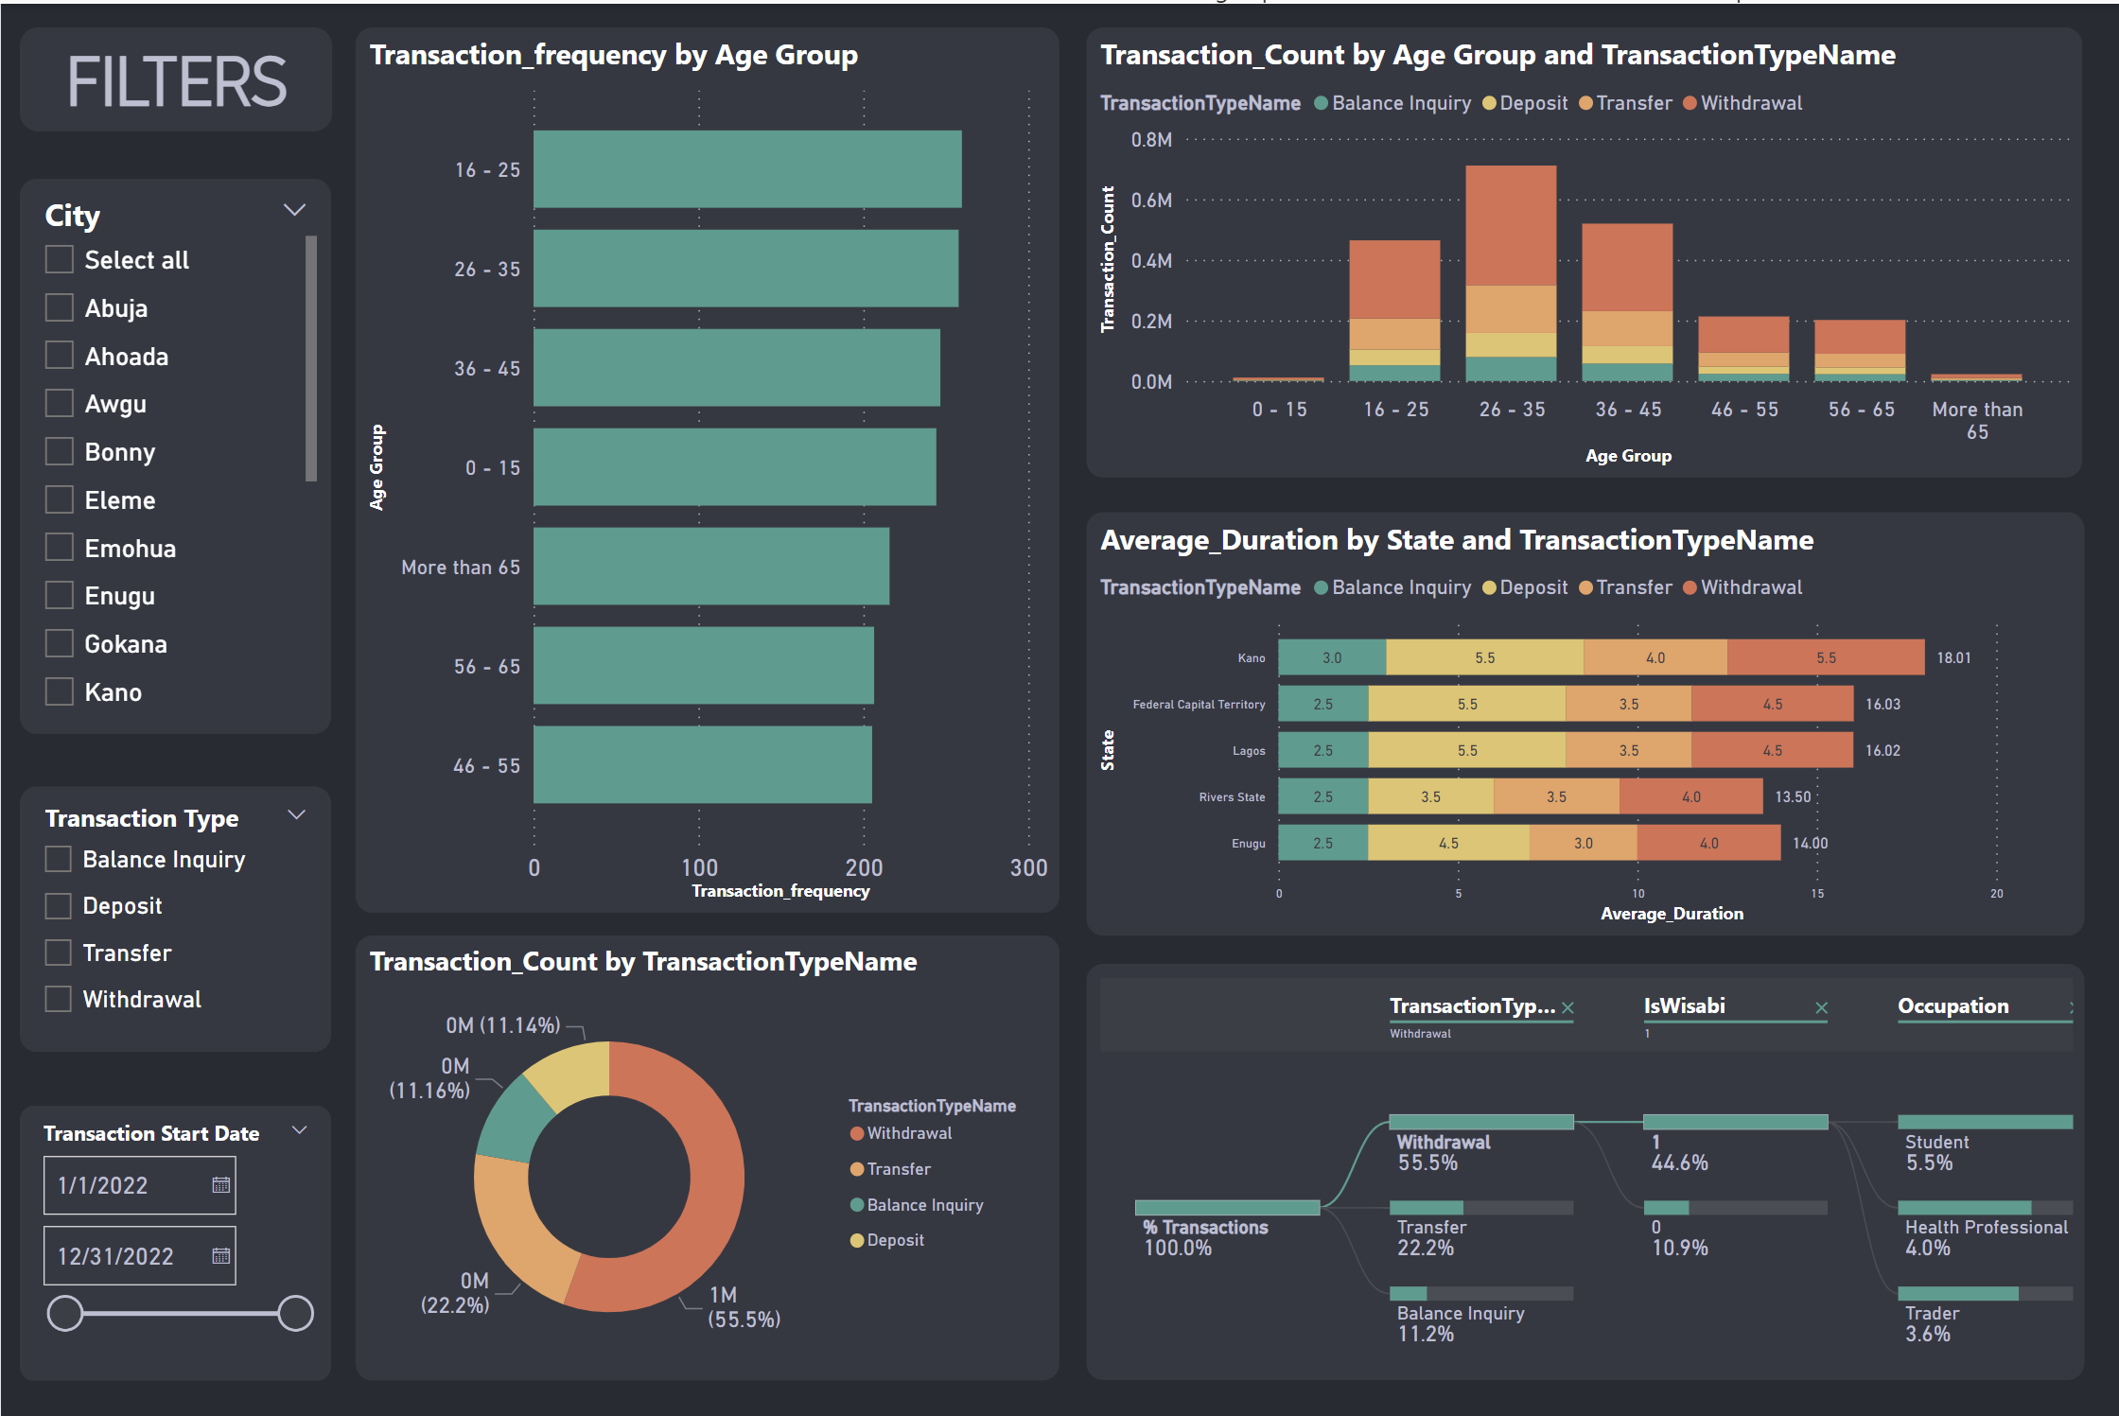
Demography
Notes:
image
No alt text provided
textbox
No alt text provided
What is the Transaction Count by Age Group & Transaction Type?
No alt text provided
What is the Transaction Distribution by Type?
No alt text provided
What is the Transaction Distribution by Demography?
No alt text provided
What is the Transaction Frequency by Age Group?
No alt text provided
What is the Average Duration by State & Transaction Type?
No alt text provided
actionButton
No alt text provided
actionButton
No alt text provided
actionButton
No alt text provided
actionButton
No alt text provided
actionButton
No alt text provided
slicer
No alt text provided
slicer
No alt text provided
slicer
No alt text provided
shape
No alt text provided

Slide 5

₦38,555,885,000
Total amount processed by Wisabi ATMs in 2022
2,143,838
Number of Transactions Processed
8819
Unique persons who carried out at least one transaction
12.9%
Utilization Rate

Slide 6
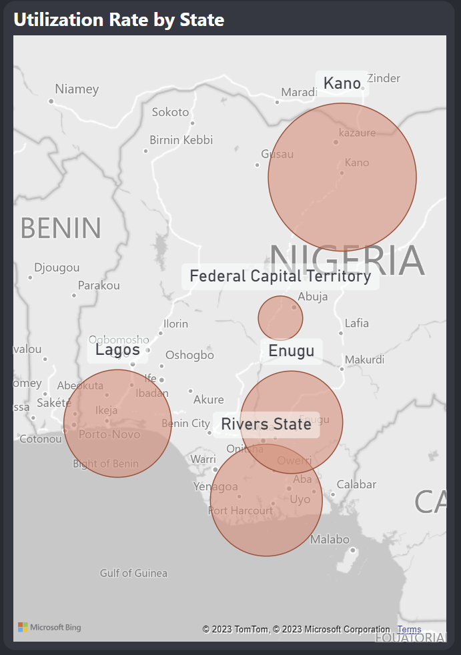
Utilization Rate
ATMs in Kano have the highest Utilization Rate (18.6%)
Rivers & Lagos have Utilization Rates greater than 12% (12.7% & 12.2% respectively) while that for Enugu is 11.6%
The FCT has the lowest Utilization Rate (8.5%)

Slide 7
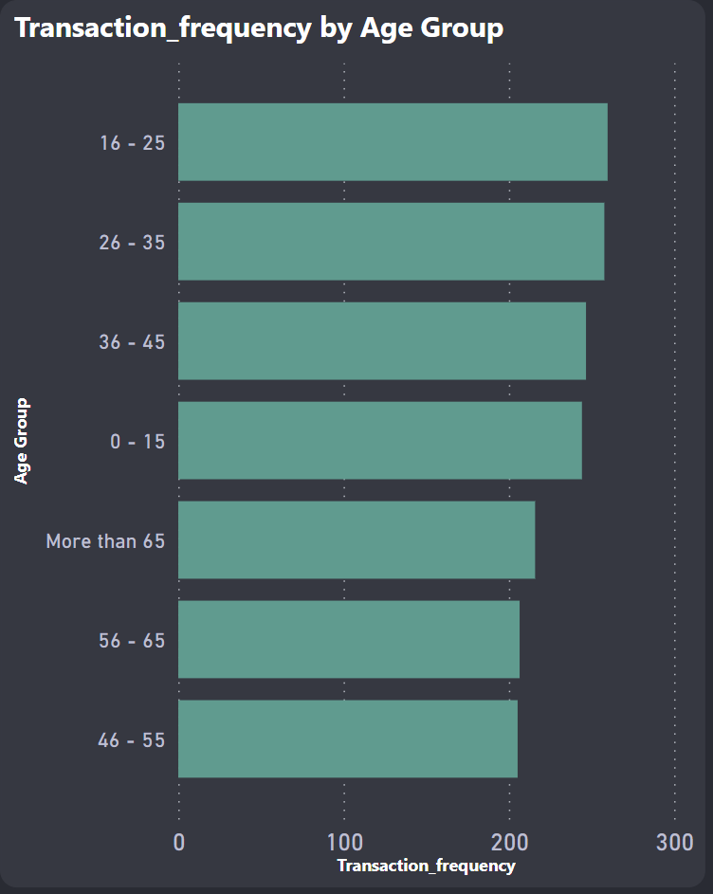
Transaction Frequency
Customers between 15-25 years have the highest transaction frequency (260).
Interestingly, customers above 65 years have a higher transaction frequency (216) than the 56 - 65 & 46 - 55 age groups (207 & 205 respectively).

Slide 8
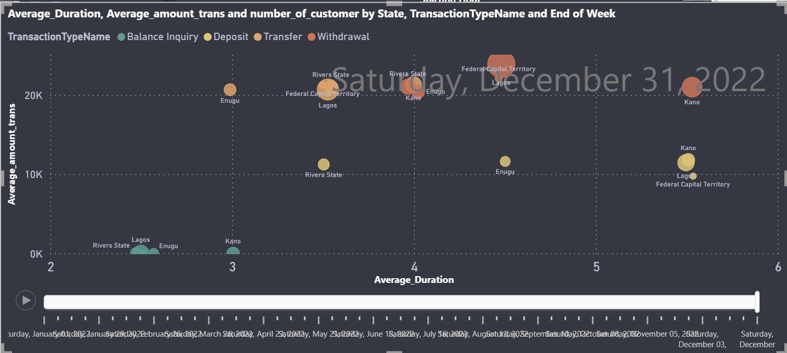
Average Amount vs Average Duration
On Average, while the transaction amount is comparatively similar, Withdrawals in Kano have the longest transaction duration (>5 mins) when compared with other states.
Kano, Lagos, and the FCT have longer transaction duration for Deposits (>5 mins) while Rivers has the lowest transaction duration for deposits.(<4 mins)
Kano also has the longest transaction duration for Balance Inquiries and Transfers
Withdrawals have the highest transaction amount on average as expected. Withdrawals and Deposits have longer transaction duration on average while Balance Inquiries have the least transaction duration.

Slide 9
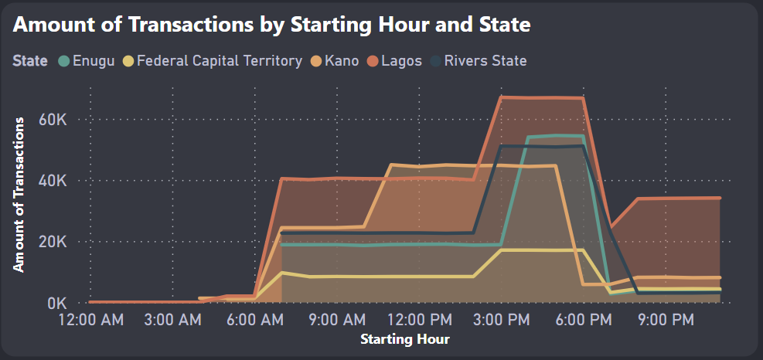
Daily Transactions Trend
ATM Transactions in Lagos increase gradually from 6 am and peaks between 3 and 7 pm.
Similar behavior is seen across other states however transactions peak earlier in Kano (around 11 am) and this is sustained till about 5 pm after which activity sharply declines.
Compared to other states, Lagos has significant transactions activity after 7 pm.

Slide 10
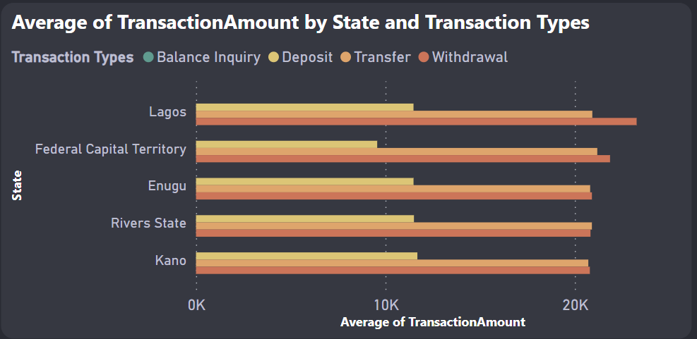
Average Transaction Amount
On Average, Withdrawals have the highest transaction amounts across all states, next is Transfers, with Deposits have the lowest.
Across all locations, The FCT has comparatively lower Deposit amounts on Average

Slide 11
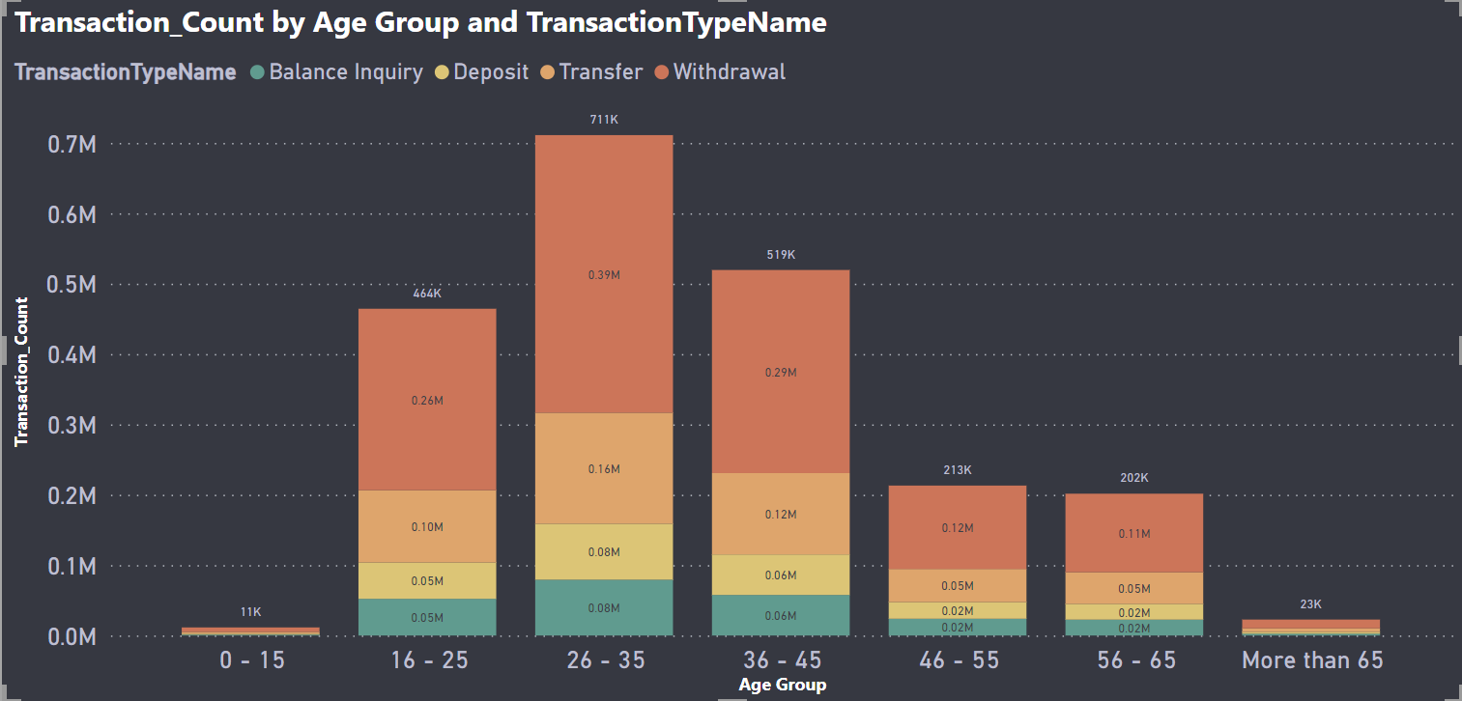
Transaction Count
Across all Age Groups, Withdrawals is the common transaction type (>50%), followed by Transfers (>20%)
Interestingly, Deposits & Transfers account for a significant amount of transactions (>10% each) across all Age Groups

Slide 12
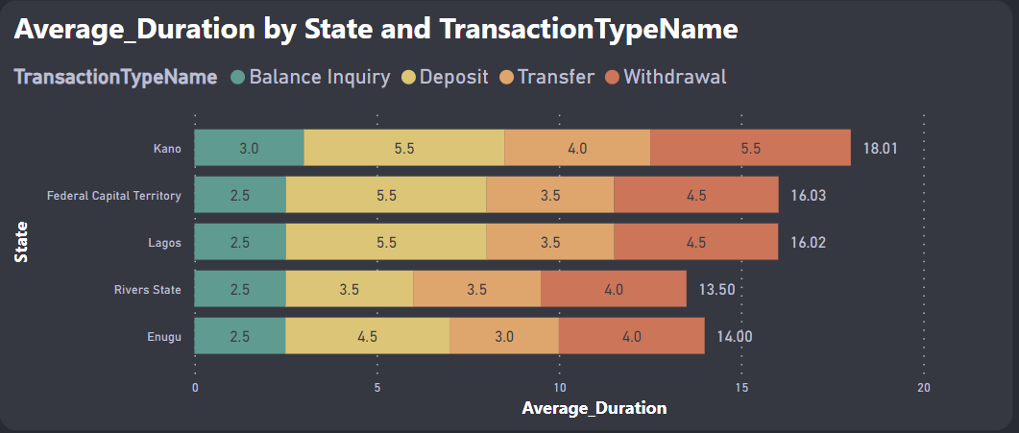
Average Transaction Duration
Across all locations, Withdrawals has the longest duration on average.
Kano’s average Withdrawal, Transfer, and Balance Inquiry durations are comparatively higher than other locations.
Rivers & Enugu have lower average transaction duration for Deposits, Transfers, & Withdrawals when compared to other locations.

Slide 13
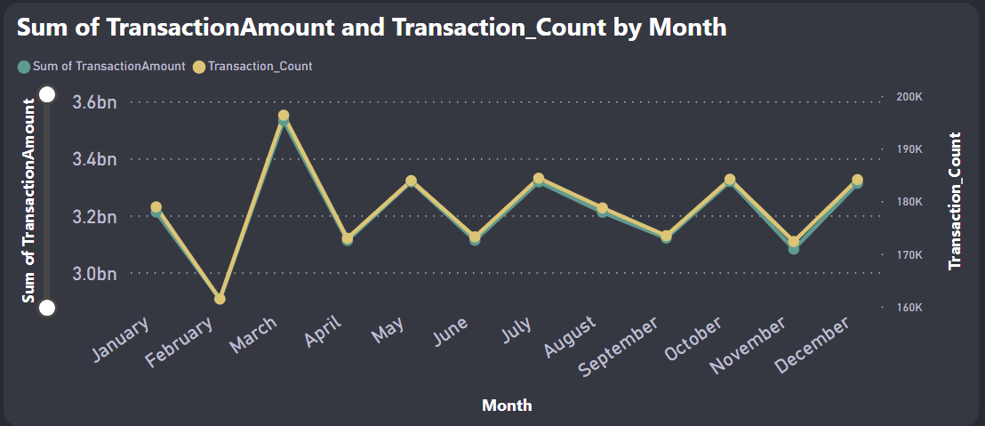
Trend of Transaction Amount & Count
We had the highest number of transactions and transaction amount in March
Other months with high transaction activity include January, May, July, October, and December
We had the lowest number of transactions and transaction amount in February

Slide 14
Recommendations
Utilization rate in the FCT is comparatively low. Possible solutions to remedy this include:
        Make sure that the ATMs are visible and accessible to customers. This could involve relocating the ATMs to more prominent locations, installing signage, or improving lighting and landscaping around the ATMs.
        Offer incentives to customers such as waived transaction fees or cashback rewards.
        Use various marketing channels to promote the availability and convenience of the ATM to customers, such as through social media, email newsletters, or in-branch promotions.
        Consider offering additional services at the ATM, such as the ability to deposit checks or make cash withdrawals in different denominations.
        Conduct surveys or use customer analytics to understand the preferences and habits of customers who use the ATM, and tailor the ATM's services and features to better meet their needs.

Slide 15
Recommendations
Average Transaction Duration in Kano is longer when compared to other locations. Possible solutions to remedy this include:
        Increase the number of ATMs available in the branch, as this can reduce wait times and congestion at each individual ATM.
        Consider upgrading the ATMs to newer models with faster transaction times and more advanced features. This can improve the overall experience for customers using the ATM and may encourage them to use it more often.
        Ensure that the ATMs are regularly serviced and maintained to prevent downtime and minimize technical issues that can contribute to longer transaction times.
        Analyze transaction data to identify bottlenecks or issues that may be contributing to longer transaction times. This could involve looking at patterns of usage, common user errors, or technical issues that may be slowing down the process.
        Provide customers with education on how to use the ATM more efficiently, such as by highlighting common errors to avoid or offering guidance on how to complete transactions more quickly.

Slide 16
Recommendations
A significant proportion of transactions (>20%) are either Balance Enquiries or Transfers. Possible solutions to remedy this include:
        Provide customers with education on alternative banking channels such as phone banking or online banking, highlighting the benefits of these channels and how to use them effectively. This could involve providing brochures or other materials in the branch, as well as online resources and tutorials.
        Consider offering incentives to customers who use alternative banking channels, such as waiving transaction fees or offering cashback rewards. This can encourage customers to try these channels and may help to shift usage away from the ATM.
        Ensure that the phone banking process is simple and straightforward for customers to use, with clear instructions and minimal waiting times.
        Continue to monitor customer behavior and analyze usage data to identify areas where usage of alternative banking channels can be improved.
        Offer personalized support to customers who may be hesitant to use alternative banking channels, such as providing one-on-one assistance or guidance on how to get started with phone banking or online banking. This can help to build trust and confidence in these channels and may help to shift usage away from the ATM.

Slide 17
Recommendations
Transactions Activity:
ATMs have significantly reduced activity in the early and late hours of the day (Before 5 am & After 8 pm). Lagos is the only exception as there is still noticeable activity after 8 pm.
Scheduled maintenance should coincide with these periods of reduced activity.
Additionally, ATMs should have maximum availability especially during the peak activity periods for each bank branch.

